Slide 1
WEB DEVELOPMENT
HTML, CSS, JS, PYTHON, JAVA, PHP

Slide 2
Contents
Introduction to web Development
Key Technologies and Languages

Slide 3
Introduction
Web development refers to the creating, building, and maintaining of websites.
It includes aspects such as web design, web publishing, web programming, and database management.
It is the creation of an application that works over the internet i.e. websites.
The word Web Development is made up of two words, that is:
Web: It refers to websites, web pages or anything that works over the internet.
Development: It refers to building the application from scratch.

Slide 4
classification
Web Development can be classified into two ways:
Front-end development
Back-end development

Slide 5
Front-end web development
Front-end web development is the development of the graphical user interface of a website, through the use of HTML, CSS, and JavaScript, so that users can view and interact with that website.
The part of a website where the user interacts directly is termed as front end.
It is also referred to as the ‘client side’ of the application.

Slide 6

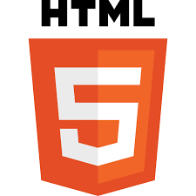


Frontend Technologies and Languages
HTML
CSS
JavaScript
Bootstrap

Slide 7
HTML
HTML stands for Hyper Text Markup Language.
It is used to design the front end portion of web pages using markup language.
HTML elements tell the browser how to display the content
It acts as a skeleton for a website since it is used to make the structure of a website.

Slide 8
Structure of HTML
The <!DOCTYPE html> declaration defines that this document is an HTML5 document
The <html> element is the root element of an HTML page
The <head> element contains meta information about the HTML page
The <title> element specifies a title for the HTML page (which is shown in the browser's title bar or in the page's tab)
The <body> element defines the document's body, and is a container for all the visible contents, such as headings, paragraphs, images, hyperlinks, tables, lists, etc.
The <h1> element defines a large heading
The <p> element defines a paragraph

Slide 9
Example
<!DOCTYPE html> <html> <head> <title>Page Title</title> </head> <body> <h1>My First Heading</h1> <p>My first paragraph.</p> </body> </html>

Slide 10
CSS
CSS stands for Cascading Style Sheets
It is used to style our website.
CSS describes how HTML elements are to be displayed on screen, paper, or in other media
CSS saves a lot of work. It can control the layout of multiple web pages all at once
External stylesheets are stored in CSS files

Slide 11
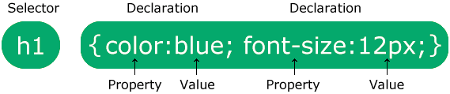
CSS Syntax
The selector points to the HTML element you want to style.
The declaration block contains one or more declarations separated by semicolons.
Each declaration includes a CSS property name and a value, separated by a colon.
Multiple CSS declarations are separated with semicolons, and declaration blocks are surrounded by curly braces.

Slide 12
Example
<!DOCTYPE html> <html> <head> <style> body { background-color: linen; } h1 { color: maroon; margin-left: 40px; } </style> </head> <body> <h1>This is a heading</h1> <p>This is a paragraph.</p> </body> </html>

Slide 13
JavaScript
JavaScript is a scripting language used to provide a dynamic behavior to our website.
JavaScript also known as a scripting language for web pages.
JavaScript is the most popular lightweight, interpreted compiled programming language
It can be used for both Client-side as well as Server-side developments
JavaScript manipulates the content to create dynamic web pages whereas HTML pages are static which means the content cannot be changed.

Slide 14
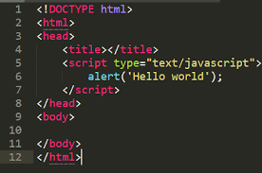
Example

Slide 15
Bootstrap
Bootstrap is an open-source front-end framework for designing websites and web applications.
It was created by Twitter and is now maintained by a team of developers.
Bootstrap provides a wide range of pre-built components and styles, making it easier for developers to create responsive and mobile-first website
Features of bootstrap are responsive design, pre-built components, customizable, cross-browser compatability , large community

Slide 16
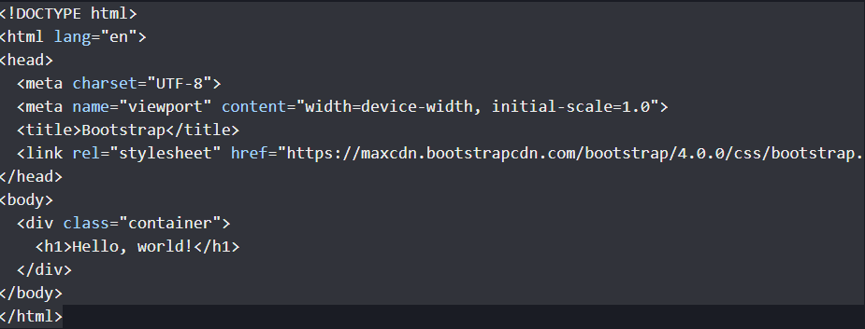
Example

Slide 17
Back-end web development
Web development activities that are done at the back end of programs are referred to as back end development.
Back-end development covers server-side web application logic and integration and activities, like writing APIs, creating libraries, and working with system components
Backend developers build code that allows a database and an application to communicate with one another.
Backend developers take care and maintain the back-end of a website, Including databases, servers, and apps, and they control what you don't see.

Slide 18

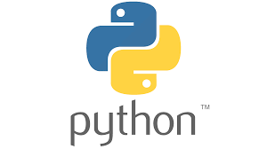


Back-end Technologies and Languages
Python
Java
PHP
Ruby

Slide 19
Python
Python is a high-level, general-purpose, and very popular programming language
Python is currently the most widely used multi-purpose, high-level programming language, which allows programming in Object-Oriented and Procedural paradigms.
Python is a programming language that lets you work quickly and integrate systems more efficiently.
The biggest strength of Python is huge collection of standard library
To use Python syntax in HTML, you can use a Python web framework like Django or Flask. These frameworks allow you to write Python code within HTML templates.
Both Django and Flask provide powerful tools for integrating Python code with HTML templates, allowing you to create dynamic web applications with ease.

Slide 20
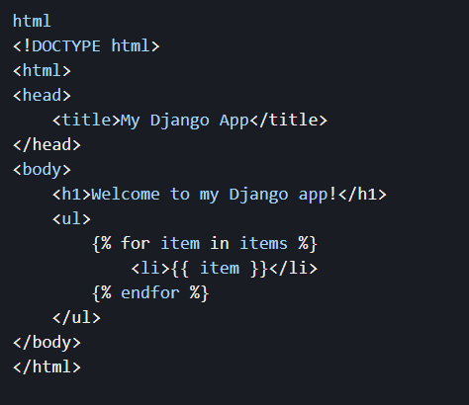
Example

Slide 21
Java
Java is also popular for backend development because it’s a platform-independent language , it has efficient memory management, and it supports high scalability — requirements of most back-end systems.
Java back-end frameworks reduce the effort required to assemble and create applications, especially for server-side programming.
At a high level, frameworks help define the structure of applications.
Some of the most popular Java frameworks for back-end development include Spring, Hibernate.
Spring Boot, a bootstrapped version of Spring, has some core capabilities that help speed up the development of standalone applications and microservices that run on the JVM, such as application configuration
Hibernate is a holistic Java framework comprising different tools primarily designed to abstract persistence login in Java applications.
While Hibernate offers Search, Validator, Reactive, and other tools, it’s best known and used as an object-relational mapping (ORM) service.

Slide 22
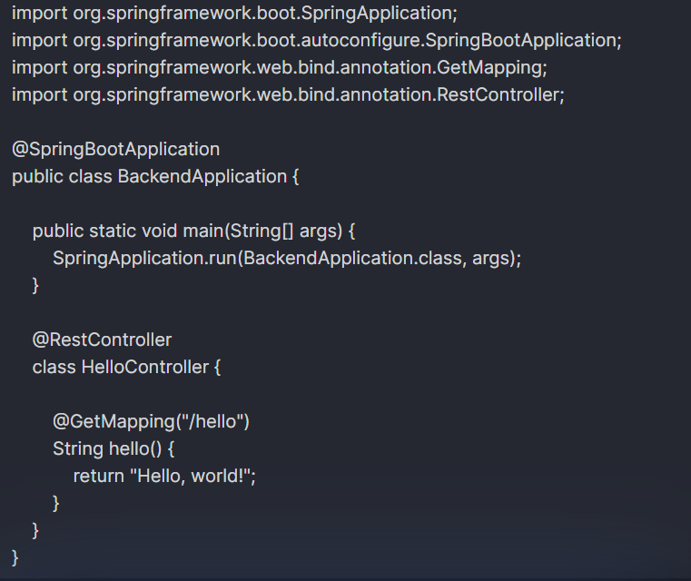
Example

Slide 23
Ruby
Ruby is a dynamic, reflective, object-oriented, general-purpose programming language.
Everything in Ruby is an object except the blocks but there are replacements too for it i . e procs and lambda.
Rails is a web application framework built on top of Ruby. It simplifies the process of building web applications by providing a set of conventions and tools.
The objective of Ruby’s development was to make it act as a sensible buffer between human programmers and the underlying computing machinery.

Slide 24
Example
To run your Ruby code, you can use the `ruby` command followed by the name of your script. For example, if your script is named `hello .rb `, you can run it by executing the following command in your terminal
bash
ruby hello . rb
This command will execute the code in `hello . rb` and print "Hello, World!" to the console.

Slide 25
PHP
Hypertext Preprocessor (PHP) is a scripting language.
PHP is an open-source HTML-embedded server-side scripting language that is used to develop dynamic and interactive web applications and also used as a general-purpose programming language
Hyper Text means, text containing all sorts of web markups, Pre Processor means all of the Hyper Text is processed first and then the result is sent as pure HTML to the web browser.
A client cannot see the PHP source code because it is preprocessed and interpreted.
PHP is Server-side scripting language: Server-side scripting means that the PHP code is processed on the web server rather than the client machine.

Slide 26
PHP Syntax
Basic PHP Syntax
A PHP script can be placed anywhere in the document.
A PHP script starts with <?PHP and ends with ?>
<?PHP // PHP code goes here ?>
The default file extension for PHP files is “.PHP "

Slide 27
Example
<!DOCTYPE html> <html> <body> <h1>My first PHP page</h1> <?php echo "Hello World!"; ?> </body> </html>

